Slide 1

FacultyHub – Faculty Module
College Scheduling System
TEAM SUDO
Deep · Nidhi · Kiran · Taslima · Jashan

Slide 2

Project Objectives
Finalize the Faculty Module
Complete and integrate the faculty module.
Deploy Full-Stack Application
Ship a production-ready app using Next.js, Prisma, Neon, and Better Auth.
Document APIs & Workflows
Provide clear API documentation, request/response contracts, and workflow diagrams.
Demo Integration
Present a live walkthrough showing integration with departments, courses, and rooms.

Slide 3

Project Overview
The Faculty Module is the backbone of the College Scheduling System, connecting people, data, and workflows in a single unified portal.
Faculty Records
Request Handling
Notifications & Timelines
Dual Portal
Manages profiles, departments, and assignments.
Swap, leave, and reschedule requests with approval flows.
Faculty portal + Admin dashboard with role-based views.
Real-time alerts and activity history for all users.

Slide 4
Technology Stack
Next.js 16
Prisma + Neon
App Router, API routes, and server-side rendering for a fast, modern frontend.
Type-safe ORM with PostgreSQL on Neon for scalable, cloud-hosted data storage.
Better Auth
Tailwind + shadcn/ui
Full authentication and session management with secure token handling.
Utility-first CSS and accessible UI components for a polished interface.
Zod + SWR
Schema validation and React data fetching for reliable, type-safe APIs.

Slide 5
Project Structure
app/
Next.js pages, routes, and layout components.
api/
Backend REST endpoints for all modules.
lib/
Helper functions, auth logic, and Zod schemas.
components/
Reusable UI elements built with shadcn/ui.
prisma/
Database schema, migrations, and ORM config.
types/
TypeScript interfaces and shared type definitions.

Slide 6
API Design & Documentation
API Endpoints
Response Format
All APIs return a consistent JSON envelope:
Faculty CRUD
Dashboard & Profile
Create, read, update, delete faculty records.
Personalized data feeds and profile management.
{
"success": true,
"data": { ... },
"error": null
}
Requests
Notifications
Swap, leave, and reschedule request APIs.
Alert delivery and notification history.
Documentation Standards
Inline comments for complex business logic
Zod schemas enforce request validation
Shared helper functions standardize responses
Stable API contracts prevent breaking changes
README covers setup, endpoints, and deployment
Admin APIs
Faculty management and system-level controls.

Slide 7



Module Integration
Users ↔ Faculty
Faculty ↔ Departments
Every faculty record is linked to a user account for authentication and profile management.
Faculty are assigned to departments, enabling filtered views and departmental scheduling.
Schedules ↔ Courses & Rooms
Timetables reference course and room records from shared tables — no duplicate logic.
All modules share a single Prisma schema and Neon database, ensuring data consistency across the system.

Slide 8
Team Contributions
Backend(Deep and Kiran)
Database design and Prisma schema
Authentication integration with Better Auth
Requests and notifications APIs
Faculty CRUD endpoints
Frontend(Nidhi, Taslima, Jashan)
Admin dashboard and faculty portal
Timetable and availability UI
Requests and notifications interface
Auth pages and role-based UI routing

Slide 9
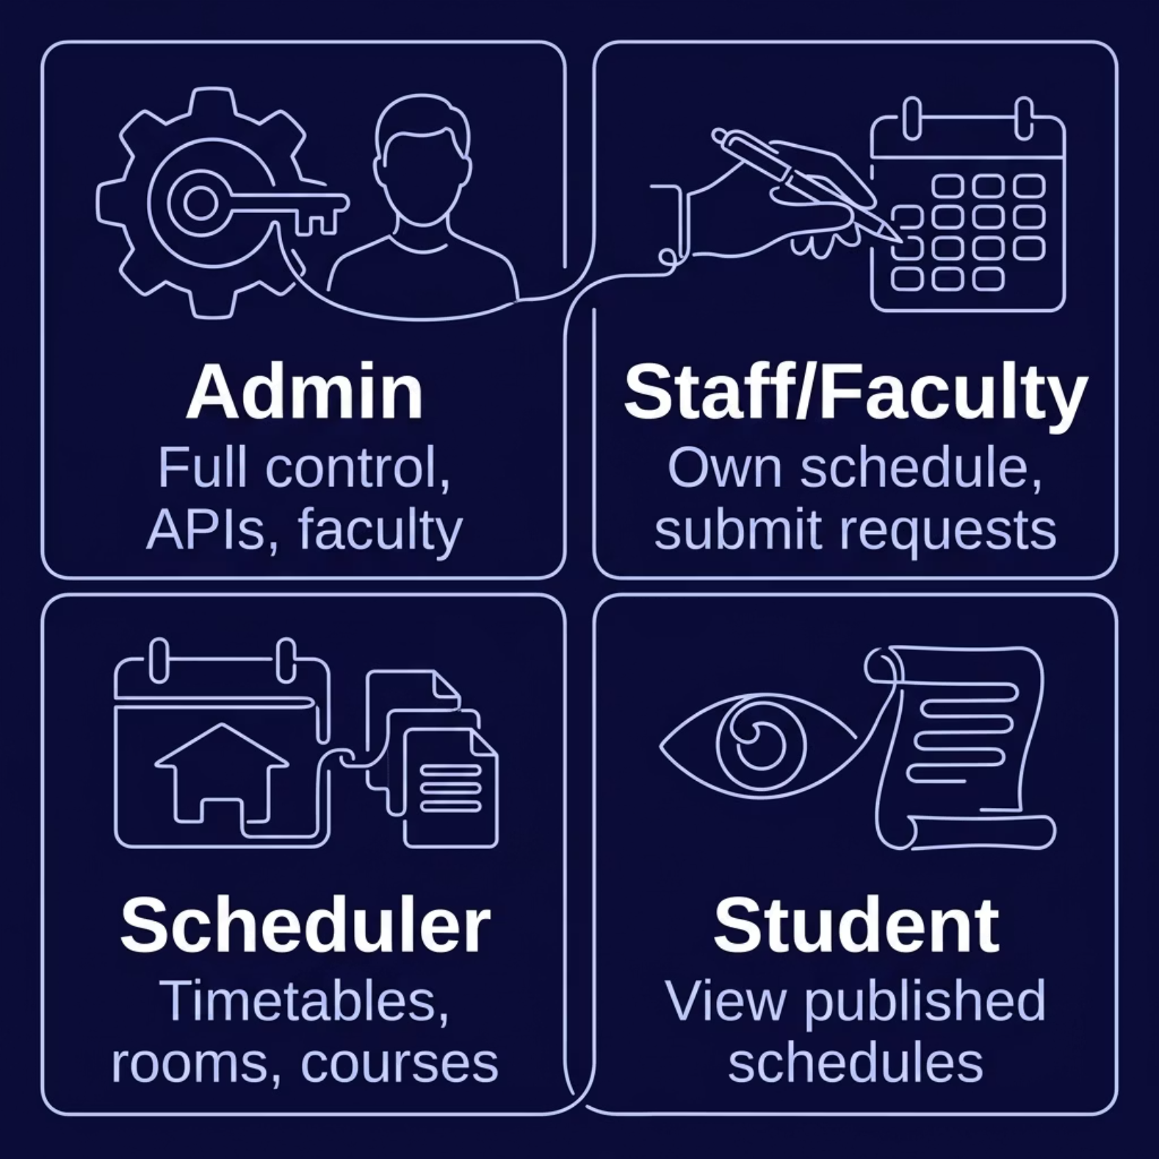

Authentication & Role-Based Access
Secure by Design
Every API route is protected by Better Auth session middleware. Role checks are enforced at both the API and UI layer.
Faculty-only portal routes are gated behind role verification
Admin APIs reject requests from non-admin sessions
Sessions are securely stored and invalidated on logout
RBAC ensures users only see and act on data they own

Slide 10

Thank You
Deep · Nidhi · Kiran · Taslima · Jashan
Thank you for your time and attention. We appreciate the opportunity to share our work and look forward to what comes next.

